Slide 1

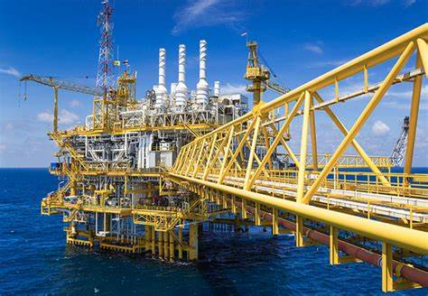
Application of Nanoparticles in Cementing Applications
Associated With: B.tech Project ( Semester 5)
(2022-23)
Mentor: Dr. Shivanjali Sharma
Associate Professor
Dept. Of Petroleum Engg. & Geoscience Engg.
Rajiv Gandhi Institute of Petroleum Technology
.
Submitted By: Utkarsh Shukla
B.Tech 3rd year , 20PE3047
&
Ritam Bishnoi
B.Tech 3rd year , 20PE3034

Slide 2
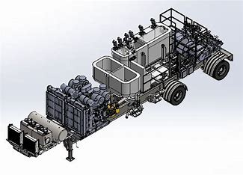
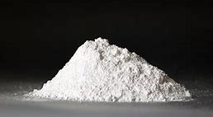
About The Project :
We are trying to increase the compressive strength of the oil well Cement along with low filtration loss.
During our project, we understood the functioning of the Autoclave and HPHT( High Pressure Temperature) filter press along with their handling and safety equipment
For achieving our goal, we have used nanoparticles ( Cuttle Fish Bone, Commercial ZnO with pack-R). We have used anhydrous CaCl2 as an accelerator for cement.

Slide 3
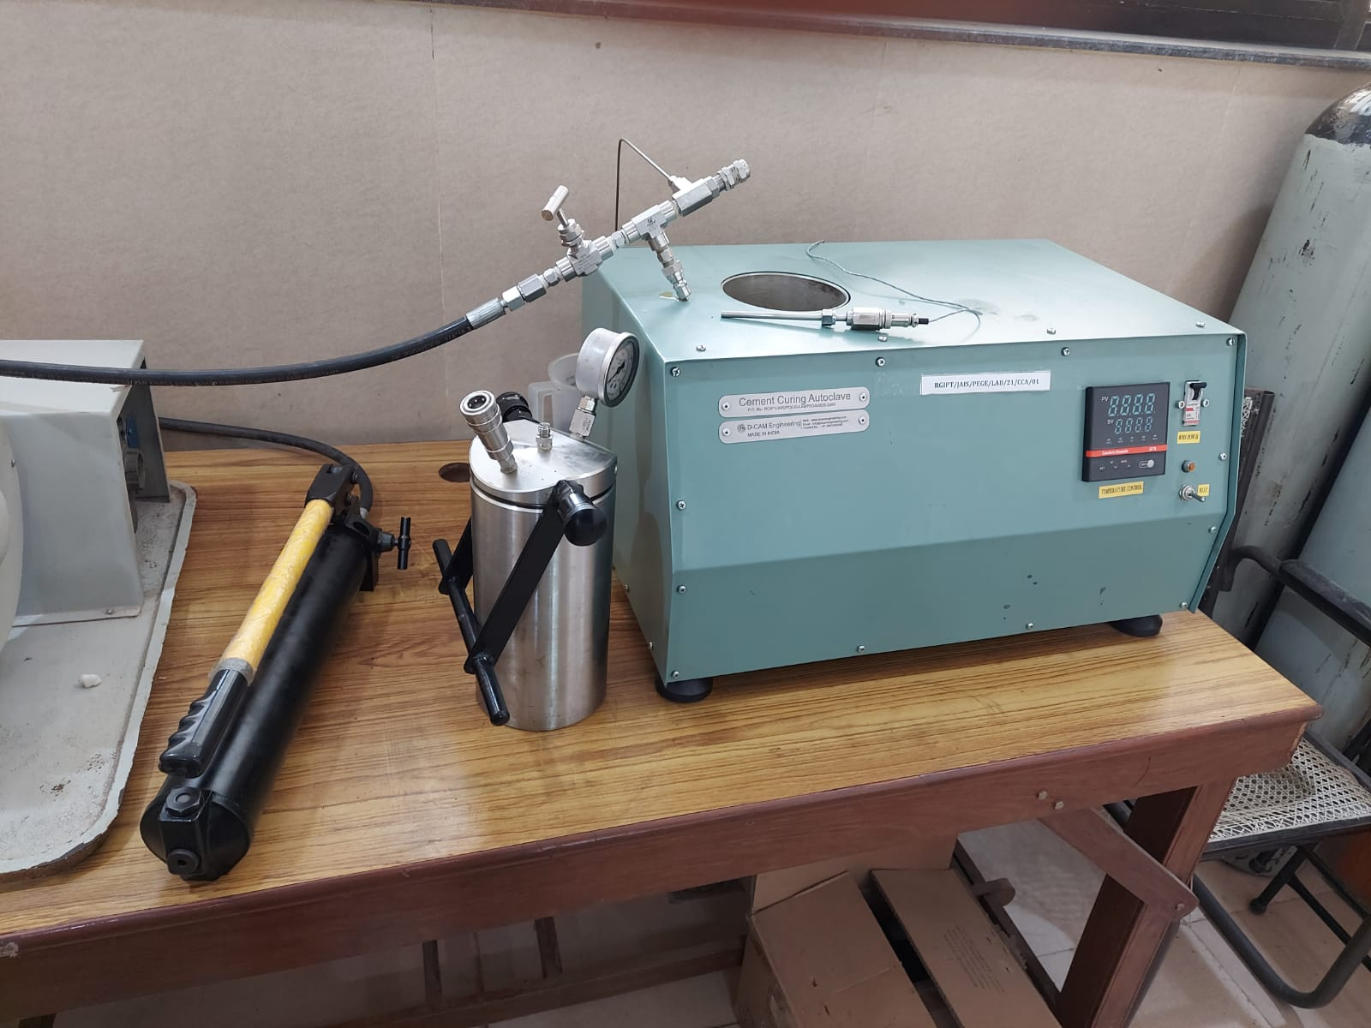
About The Equipment :
1. Autoclave :
Autoclave instrument is used for making cement blocks. The blocks are made by using a cubical solid mold. The reservoir conditions are also implemented by applying pressure and temperature.

Slide 4
Continued….
HANDLING EQUIPMENT FOR AUTOCLAVE :
Temperature probe- for measuring the temperature.
Jar- a cylindrical jar of steel in which cubes filled with cement slurry are kept
Rod and chain plier- it is used to open and close the cap of the jar tightly.
Grease- applied in the metallic cubic mold to prevent the sticking of cement.
Handlebar pressure equipment- used to apply pressure
Temperature Probe
Blower
Pressure Probe

Slide 5
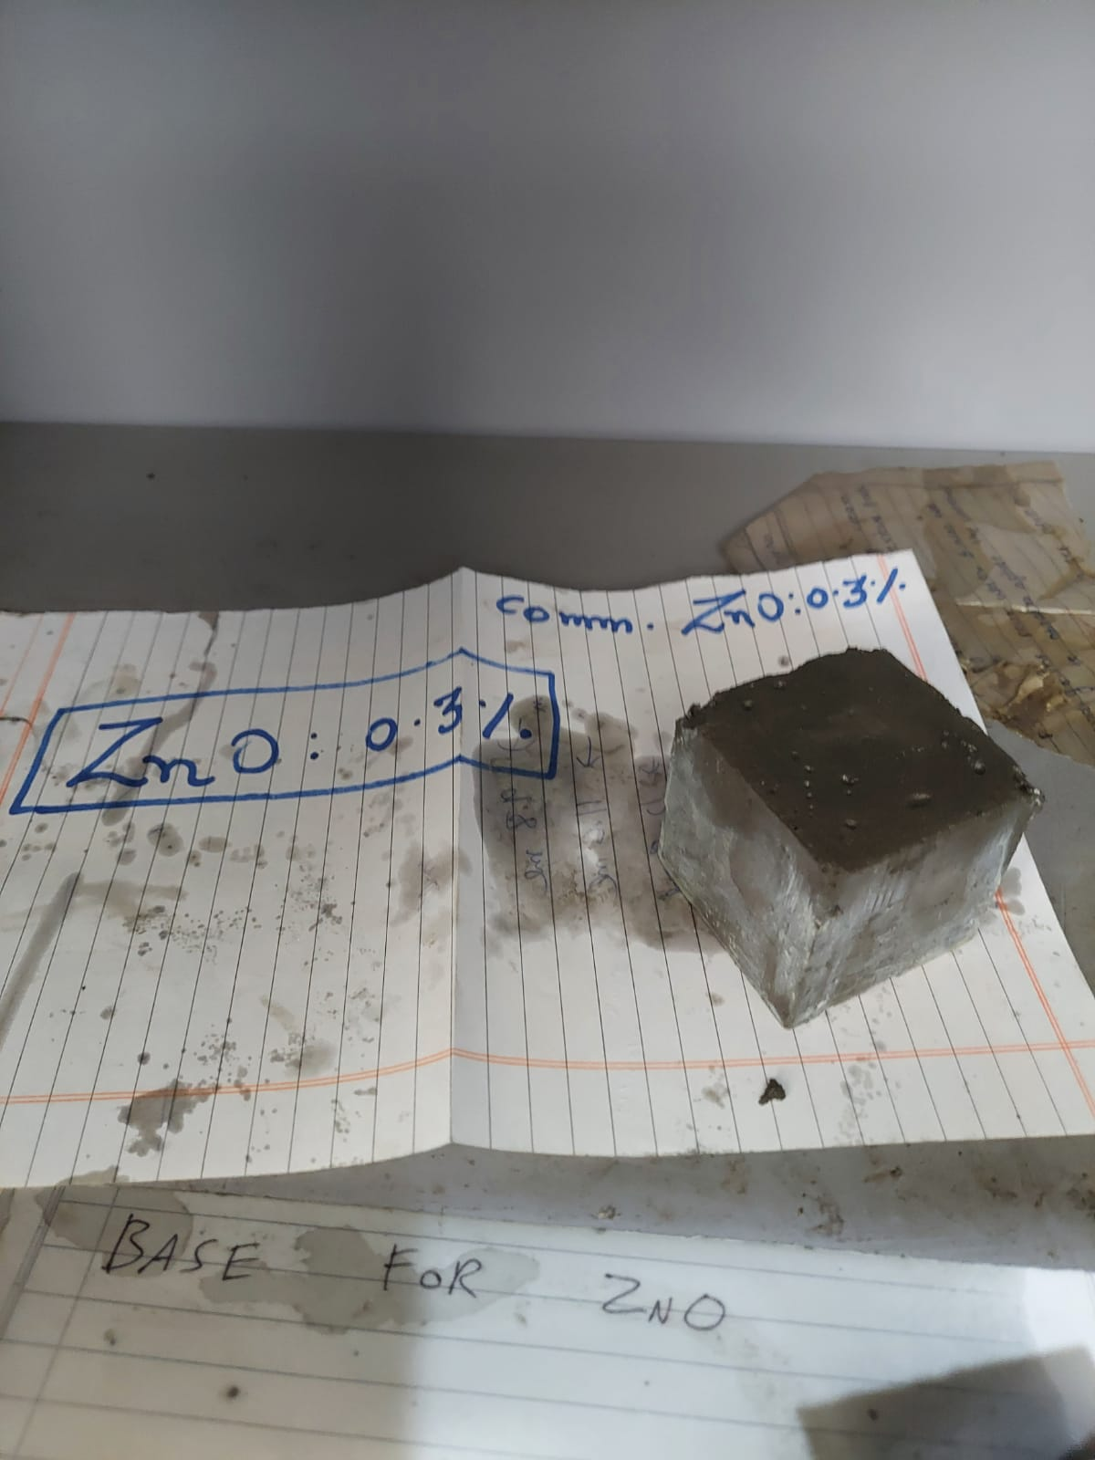
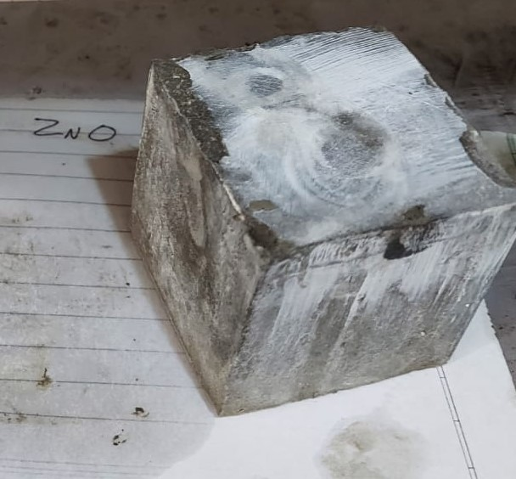
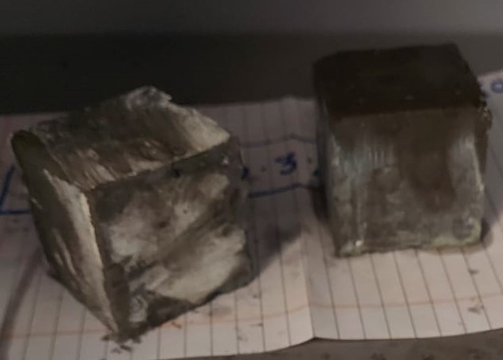
Continued….
Working Procedure :
Assembling of cubical mold.
Slurry preparation by a cement mixer.
Pour slurry into a greased cubical mold.
Put the cubes in a steel jar filled with half oil.
Then seal the jar with a cap and place it in the autoclave machine.
Give temperature(80 degree celsius) and pressure(2000 psi).
Leave the instrument running for 24 hours.
Then carefully remove the cubes.

Slide 6
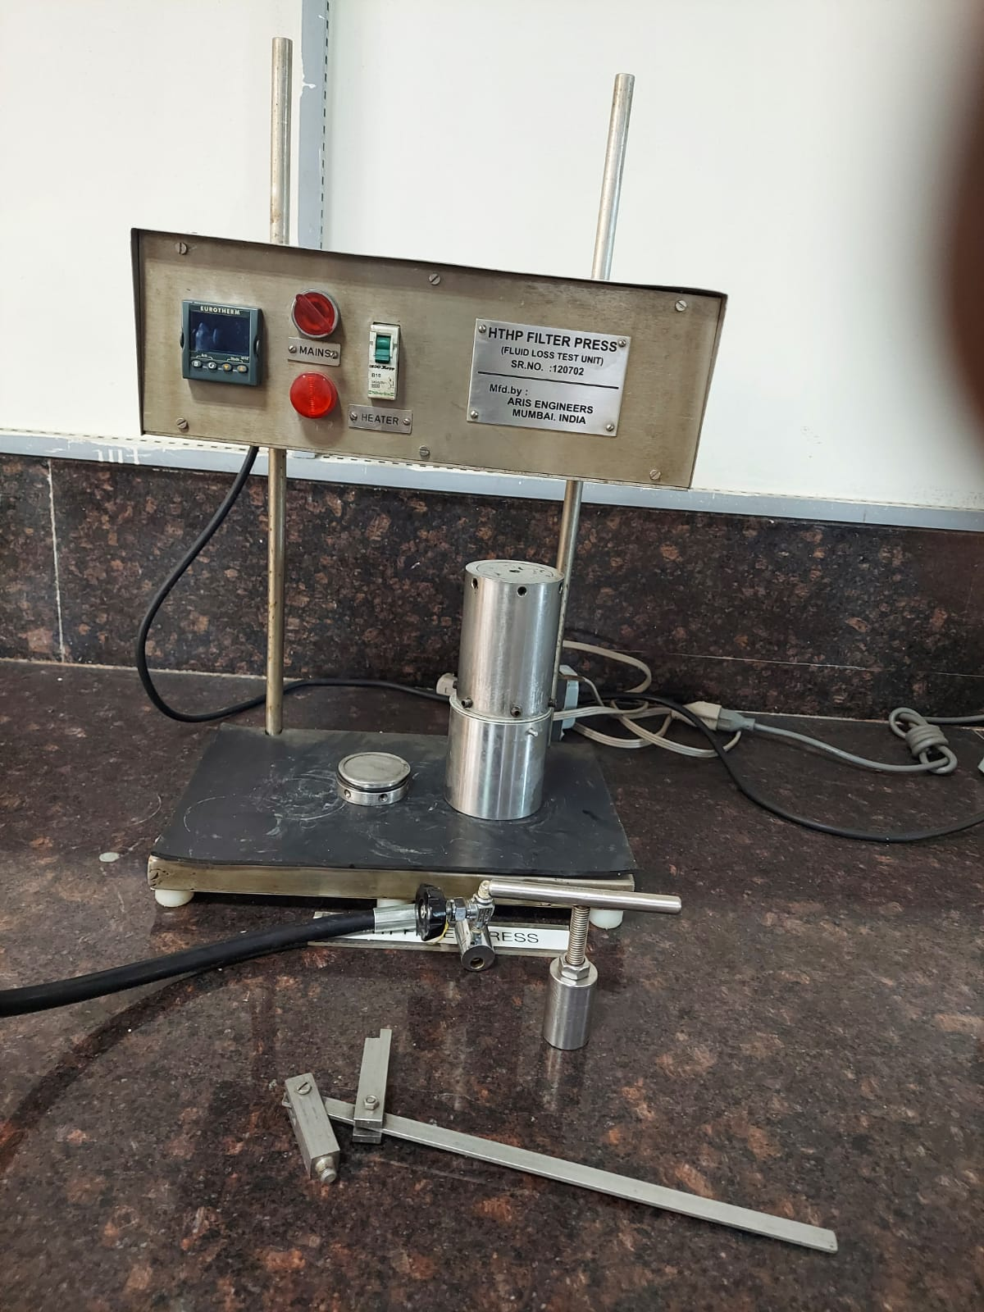
Continued….
2. HPHT FILTER Press :
(High Pressure – High Temperature)
The HPHT filter press drilling fluid test is used for measuring the filtration and filter-cake building properties of the drilling fluid at elevated temperature and pressure. The instrument comprises a mud cell that can be pressurized with back-pressure through valve stems.

Slide 7
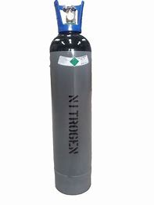
Continued….
HANDLING EQUIPMENT FOR HPHT FILTER TEST
HPHT Cell- cylindrical vessel where cement slurry is kept for filtration test.
Pressurized gas cylinder- used to apply required pressure for the test.
Measuring tube- used to measure the filtrate volume.
Cell carrying tool- used to move cell from one place to another place.
Cap removal tool- used to remove the cap of the cell after doing the experiment.
Gas Cylinder
HPHT Cell
Cap Removal Tool
Cap Carrying Tool

Slide 8
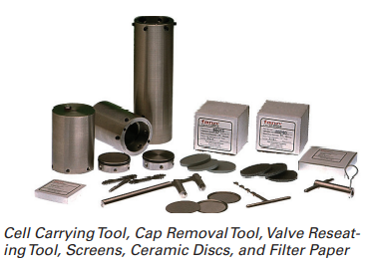
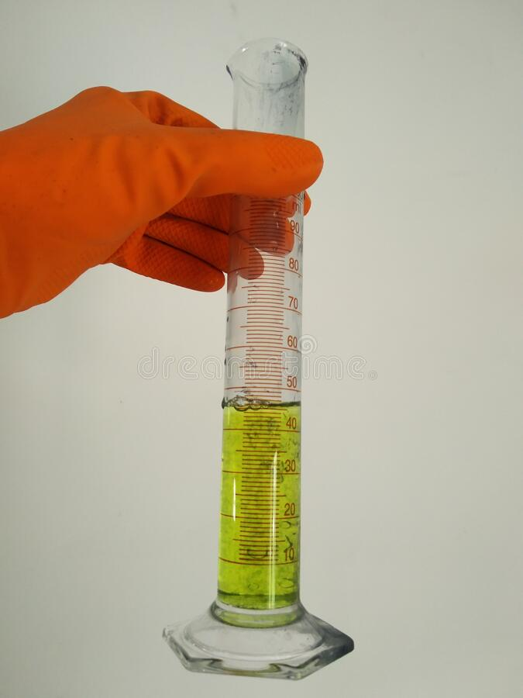
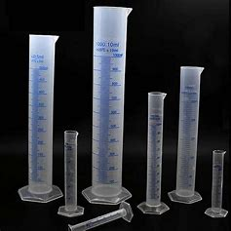
Continued….
Working Procedure :
Assemble the cell properly.
Prepare cement slurry by using a cement mixer.
Pour cement slurry into the cell.
Then close the cell tightly with screws.
Set the temperature of the HPHT setup at 80-degree celsius.
Place the cell in the HPHT set-up.
Connect the pressure line to the cell at 500 psi.
Start taking the reading till API time of 30 minutes.
Measuring Cylinder
Spud Loss
Accessories

Slide 9
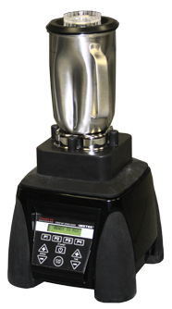

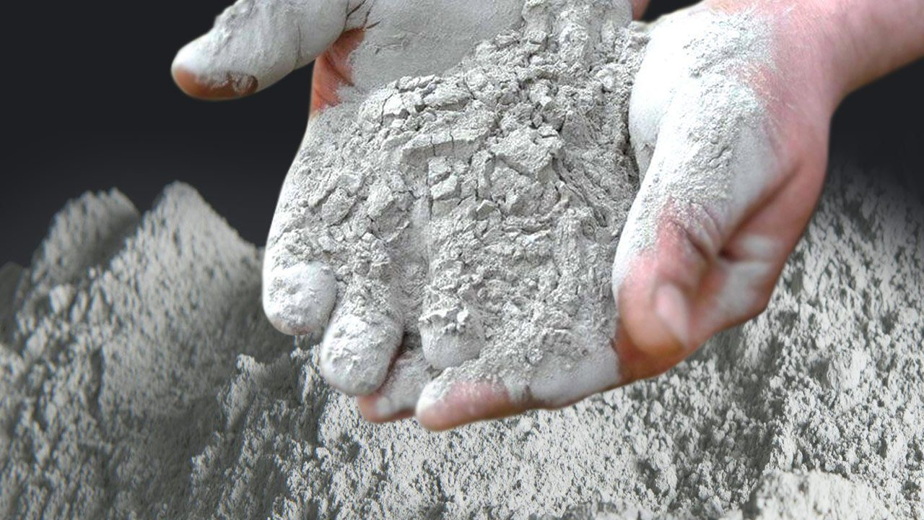
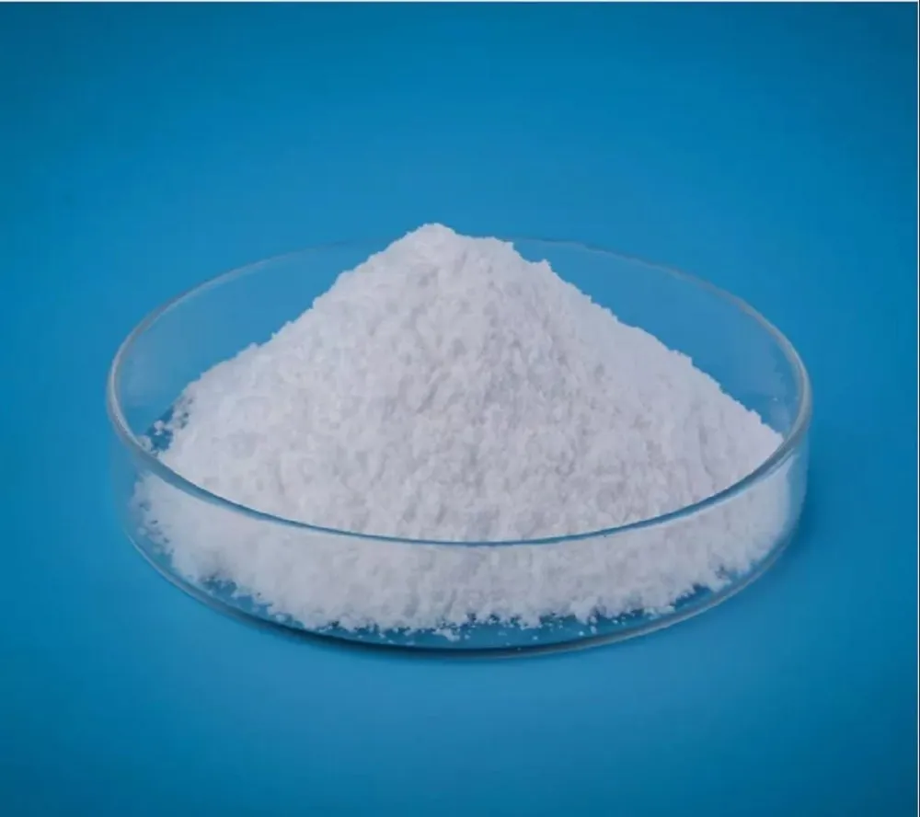
Additional Equipment :
Cement Slurry Mixer :
First, pour water into the mixer and start adding the cement appropriately.
After adding the cement, start adding the additives and polymers to be added in the cement slurry.
Make sure that all the additives are added in the first 83 seconds when the machine is running at 4000 rpm.
After mixing all the additives, stir the cement slurry for 35 seconds at 12000 rpm.
Now the cement slurry is ready for use in different experiments.
Stabilizer
Cement
Cement Additive
Mixer

Slide 10
The Role of Cuttle Fish Bone:
Cuttle Fish Bone is a 100% natural source of essential calcium(85%). Cuttle Fish Bone powder contains high amount of Calcium Carbonate, which is believed can improve the cement’s strength to achieve early strength.
Slurry Composition :
Cement: 600 gm
Water: 44% BWOC (264 mL of water with s.g. 1.0)
Anhy. CaCl2: 0.5% BWOC (3 gm)
The concentration of Cuttle Fish bone powder will be varied from 0 to 1 % BWOC)

Slide 11
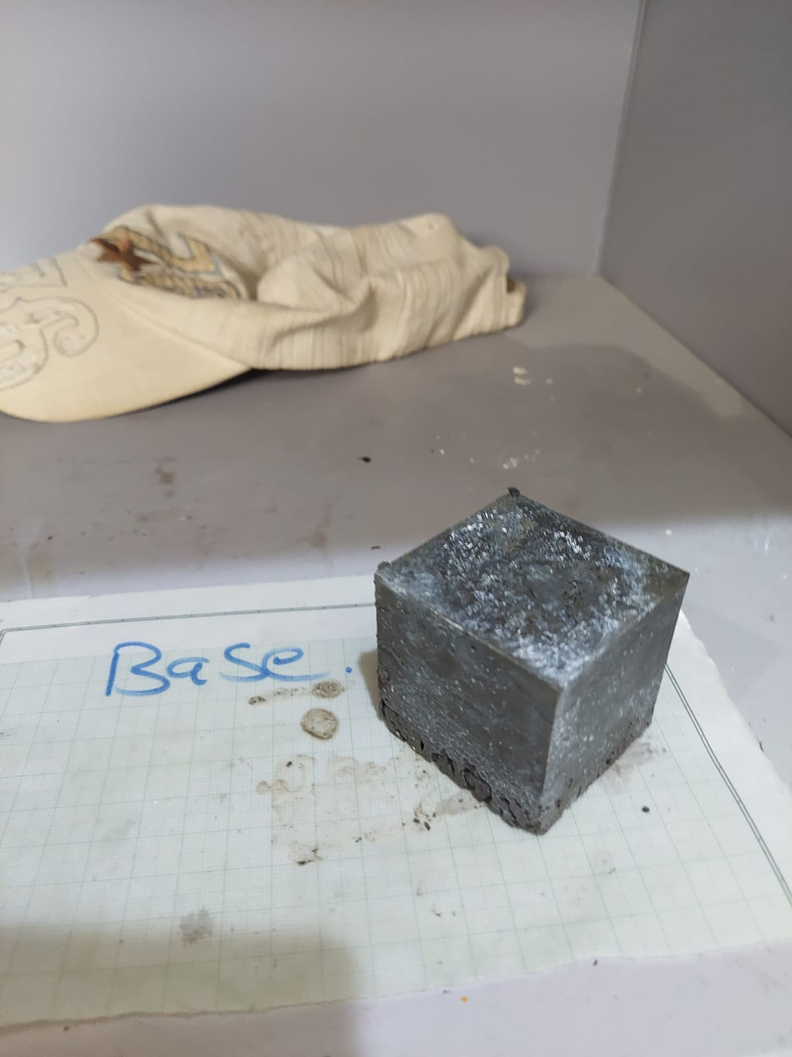
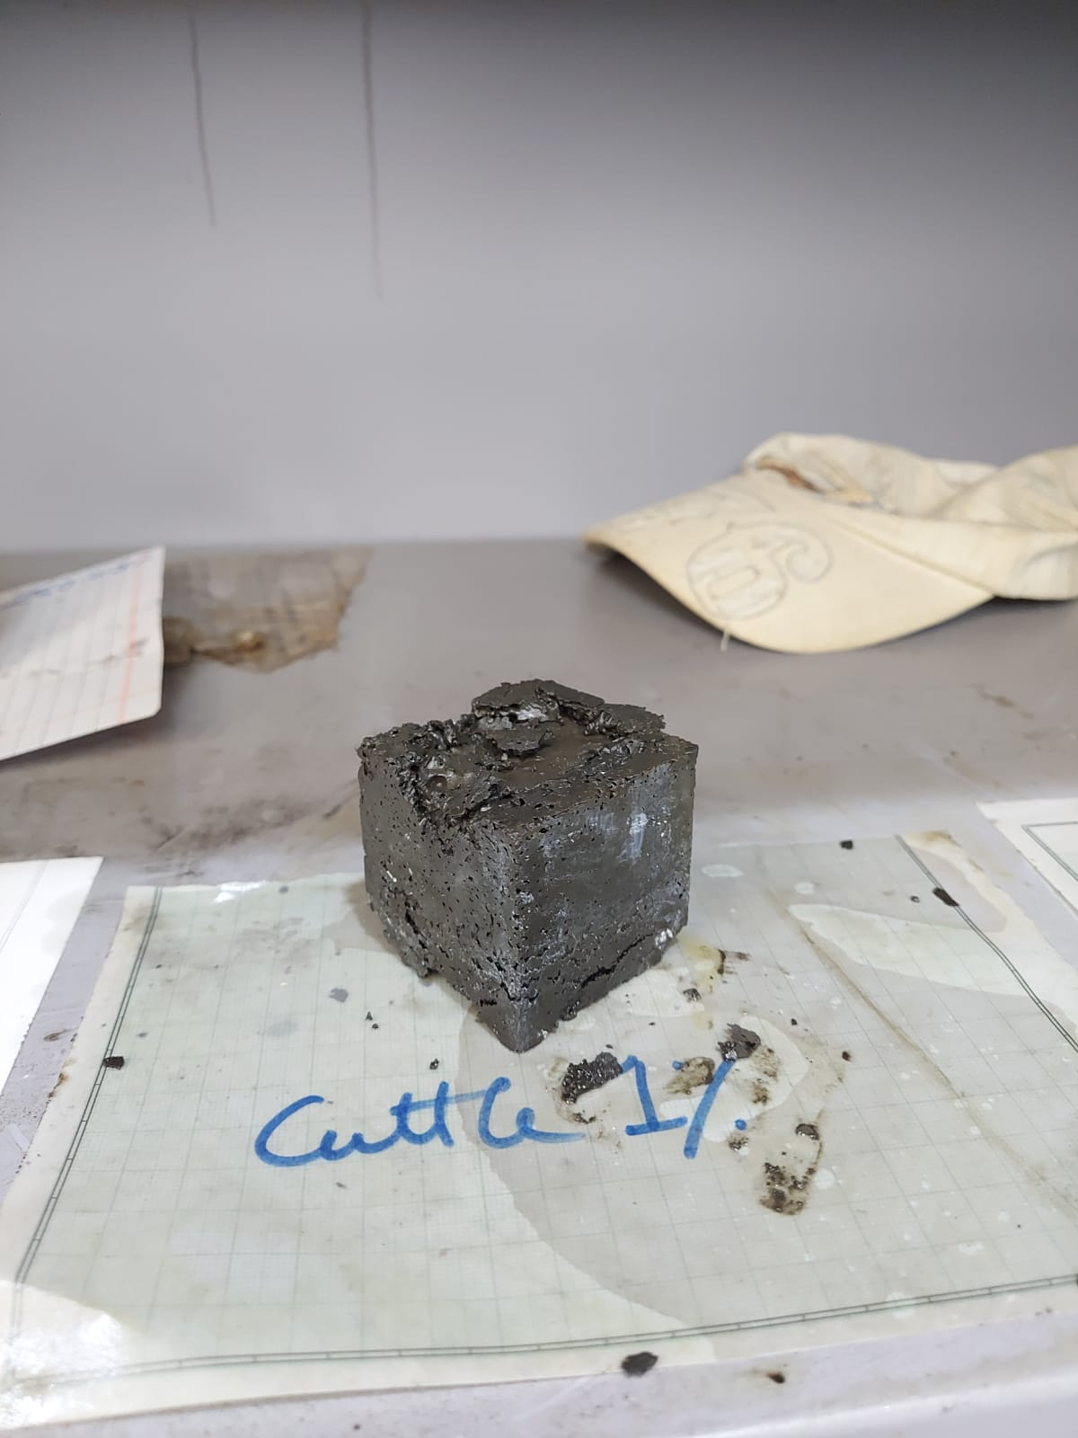
Continued….
Autoclave Result :
Working Pressure: 2000 Psia
Working Temperature: 80 degree Celcius
Base Conc.
Well Shaped Block
Reason: Nano-particle is not able to disperse if its conc. is that much high.
1% BWOC
0.5% BWOC
Poor Shaped Block
Intermediate Shaped Block

Slide 12
Continued….
HPHT Result (Working Pressure: 500 Psia)
S. No. | Conc. Of Cuttle Fish Bone (Bi- Calcium , Nano-Particle) | Spud Loss
1 | Base conc. ( 0% BWOC) | 47mL
2 | 0.5% BWOC | 43mL
3 | 1.0% BWOC | 42mL
Interpretation :
1. Spud loss is quite high than expected so it is clearing showing that the channeling takes place in cement.
2. Only Cuttlefish bone is not sufficient. We have to use any other additives to reduce filteration loss.

Slide 13
The Role of Zinc Oxide (ZnO):
The zinc oxide cement includes zinc oxide, an element known as rosin, and zinc acetate in the form of powder as well. The formation of zinc oxide eugenol chelate makes the cement solidify and harden.
Role of Pack-R :
It is used to reduce spud loss. But a limitation is also associated with it. It is not economically buyable on the industrial level.
Slurry Composition :
Cement: 600 gm
Water: 44% BWOC (264 mL of water with s.g. 1.0)
Anhy. CaCl2: 0.2% BWOC (1.2 gm)
Pack-R : 0.5% BWOC(3 gm)
The concentration of ZnO powder will be varied BWOC)

Slide 14
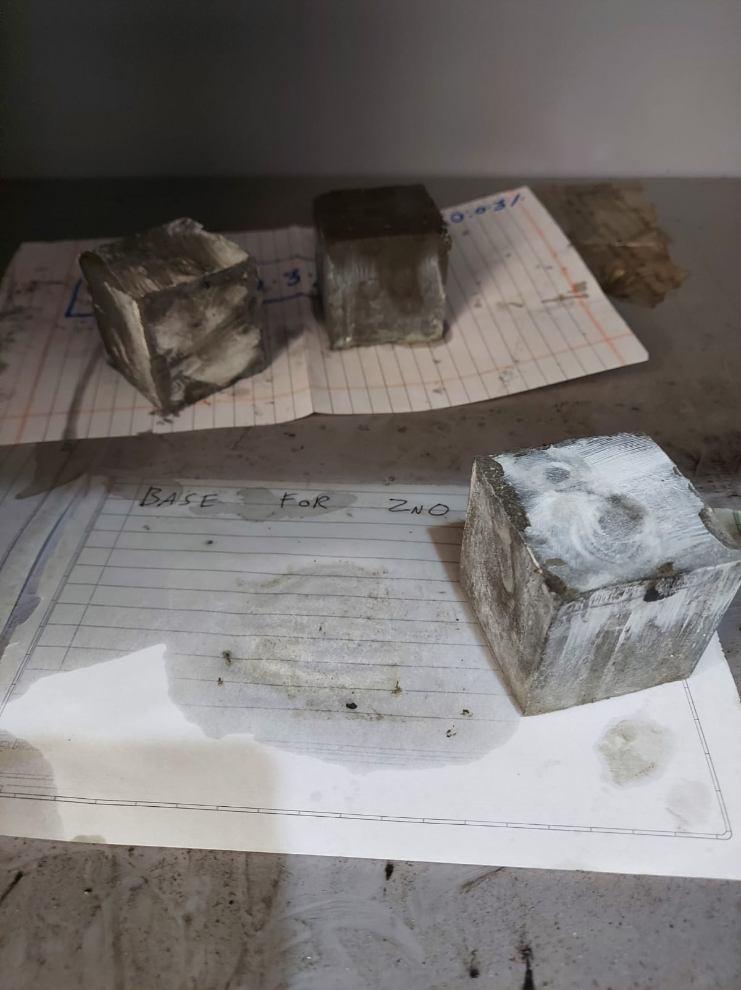
Continued….
Autoclave Result :
Working Pressure: 2000 Psia
Working Temperature: 80 degree Celcius
Base Conc.
Note: The block shape is perfect by using ZnO with pack-R.
0.15% BWOC
0.30% BWOC

Slide 15
Continued….
HPHT Result (Working Pressure: 500 Psia)
S. No. | Conc. Of Zinc Oxide (Zn0 , Nano-Particle) | Spud Loss
1 | Base conc. ( 0% BWOC) | 25mL
2 | 0.15% BWOC | 23mL
3 | 0.3% BWOC | 22mL
Interpretation :
1. Spud loss gets reduced compared to cuttlefish bone but it is still high enough and it’s not desired.
2. There is not so much effect of pack-R on process and it is quite costly. So we will not continue our further work with this.

Slide 16
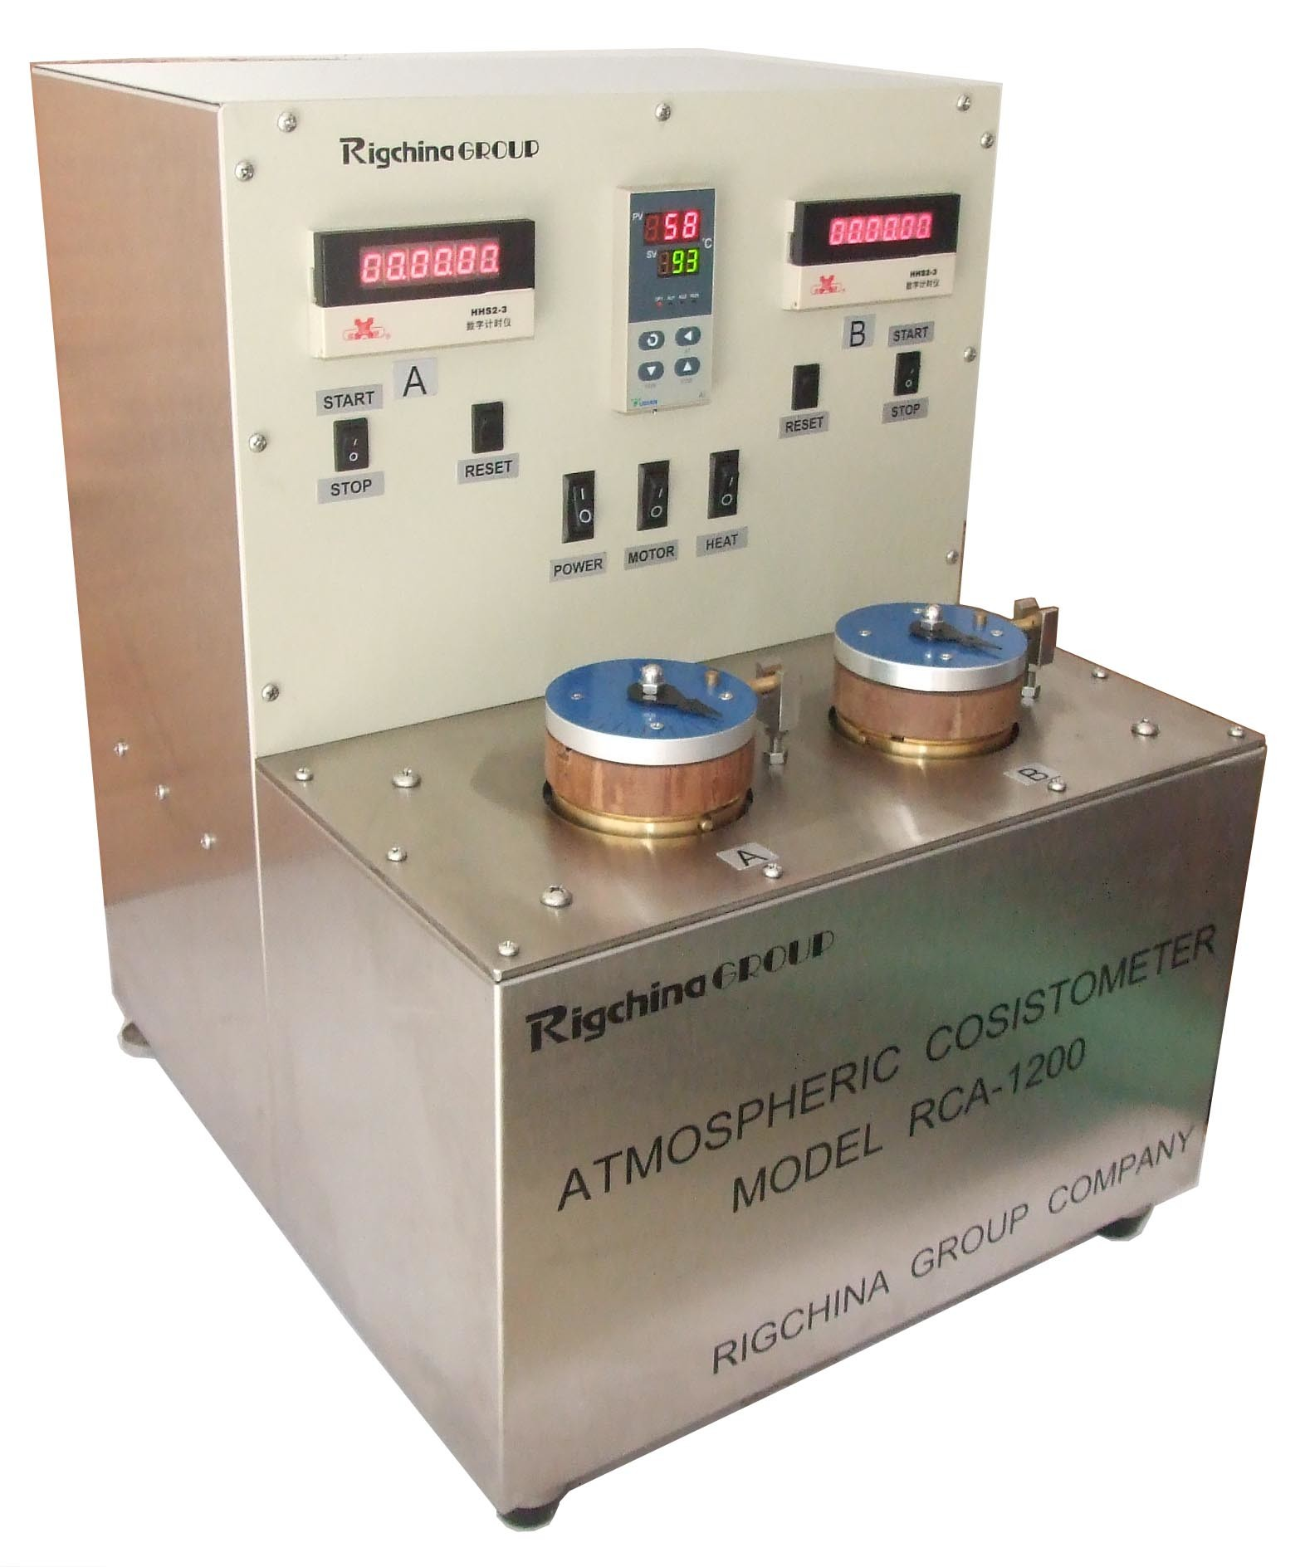
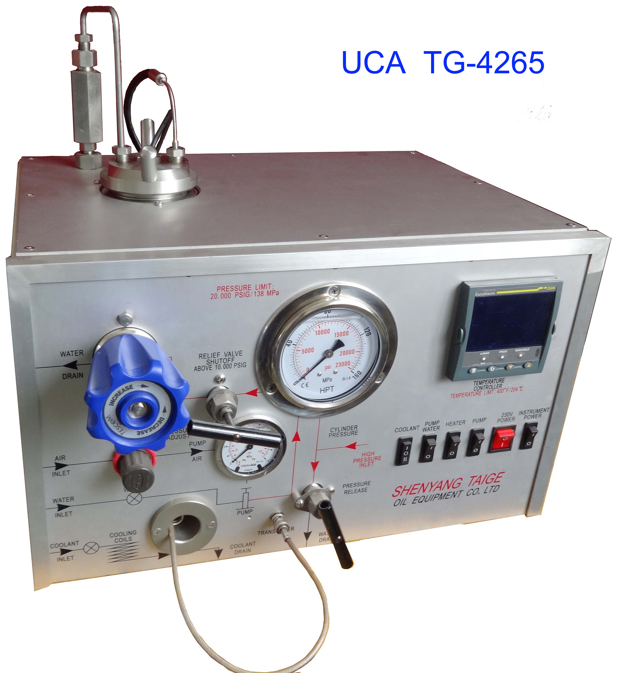
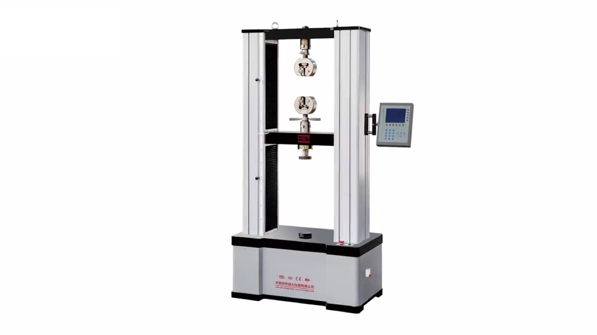
Future Scope :
We will now use a new polymer called Tetra polymer(TP). This polymer will be synthesized.
We will again perform the autoclave and HPHT filter test with this polymer.
If the results are appreciable then we will proceed with the further test by use of-
1. UCA for compressive strength testing
2. Consistometer for cement consistency
3. UTS for compressive strength testing
UTS
Atmospheric Consistometer
Ultrasonic Cement Analyzer

Slide 17
Precautions :
Measure the weight of additives to be added in the cement very accurately.
Prepare the cement slurry by adding all the additives in a time duration of 118 seconds (remember to stir the slurry at 12000 rpm for 35 seconds).
Make sure that cement slurry do not spill out of the cement mixer.
Always wash the cement mixer equipment after making a cement slurry.
Always use a stabilizer for a steady power supply to prevent damage to equipment.
Fill the oil in an autoclave jar up to a safe height otherwise, the oil will flow out.
Clean the solid block mold after use.

Slide 18
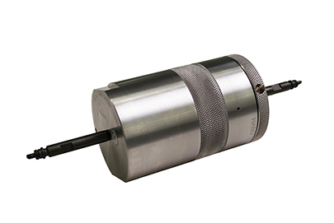
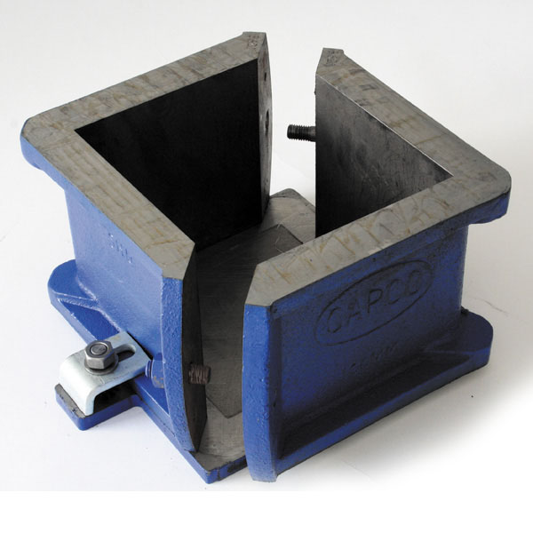
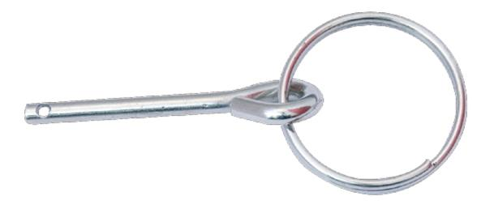
Continued….
Use the pressure release pin in the HPHT filter test.
Clean the HPHT cell after use, otherwise, cement will get stuck in the cell edges.
Remember to first tighten the upper cap of the HPHT cell, after that only cement slurry will be poured in the cell.
Let the HPHT cell be cooled down before opening it.
Cell
Cube
Safety Pin

Slide 19
Acknowledgement :
We wish to express our deep gratitude to the Rajiv Gandhi Institute of Petroleum Technology, Amethi, Uttar Pradesh India for providing an opportunity to work on the project of oil well cementing. We sincerely thank Petroleum Engineering & Geoscience Engineering Department, for their great support in doing our study. We are thankful to Dr. Shivanjali Sharma for providing us a deep understanding of such an interesting topic. This work can’t be possible without her valuable guidance. We are also thankful to PhD Scholars and M.tech students for their constant support.
Finally, We have not any words to express our gratitude to our parents who have shown us this world and for each and every support they have given us. This project has provided us the best exposure to knowing cement-related operations in oil and gas fields.

Slide 20
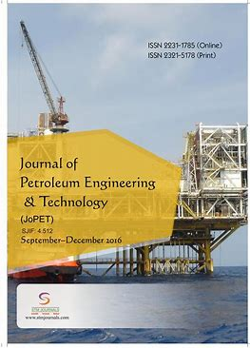
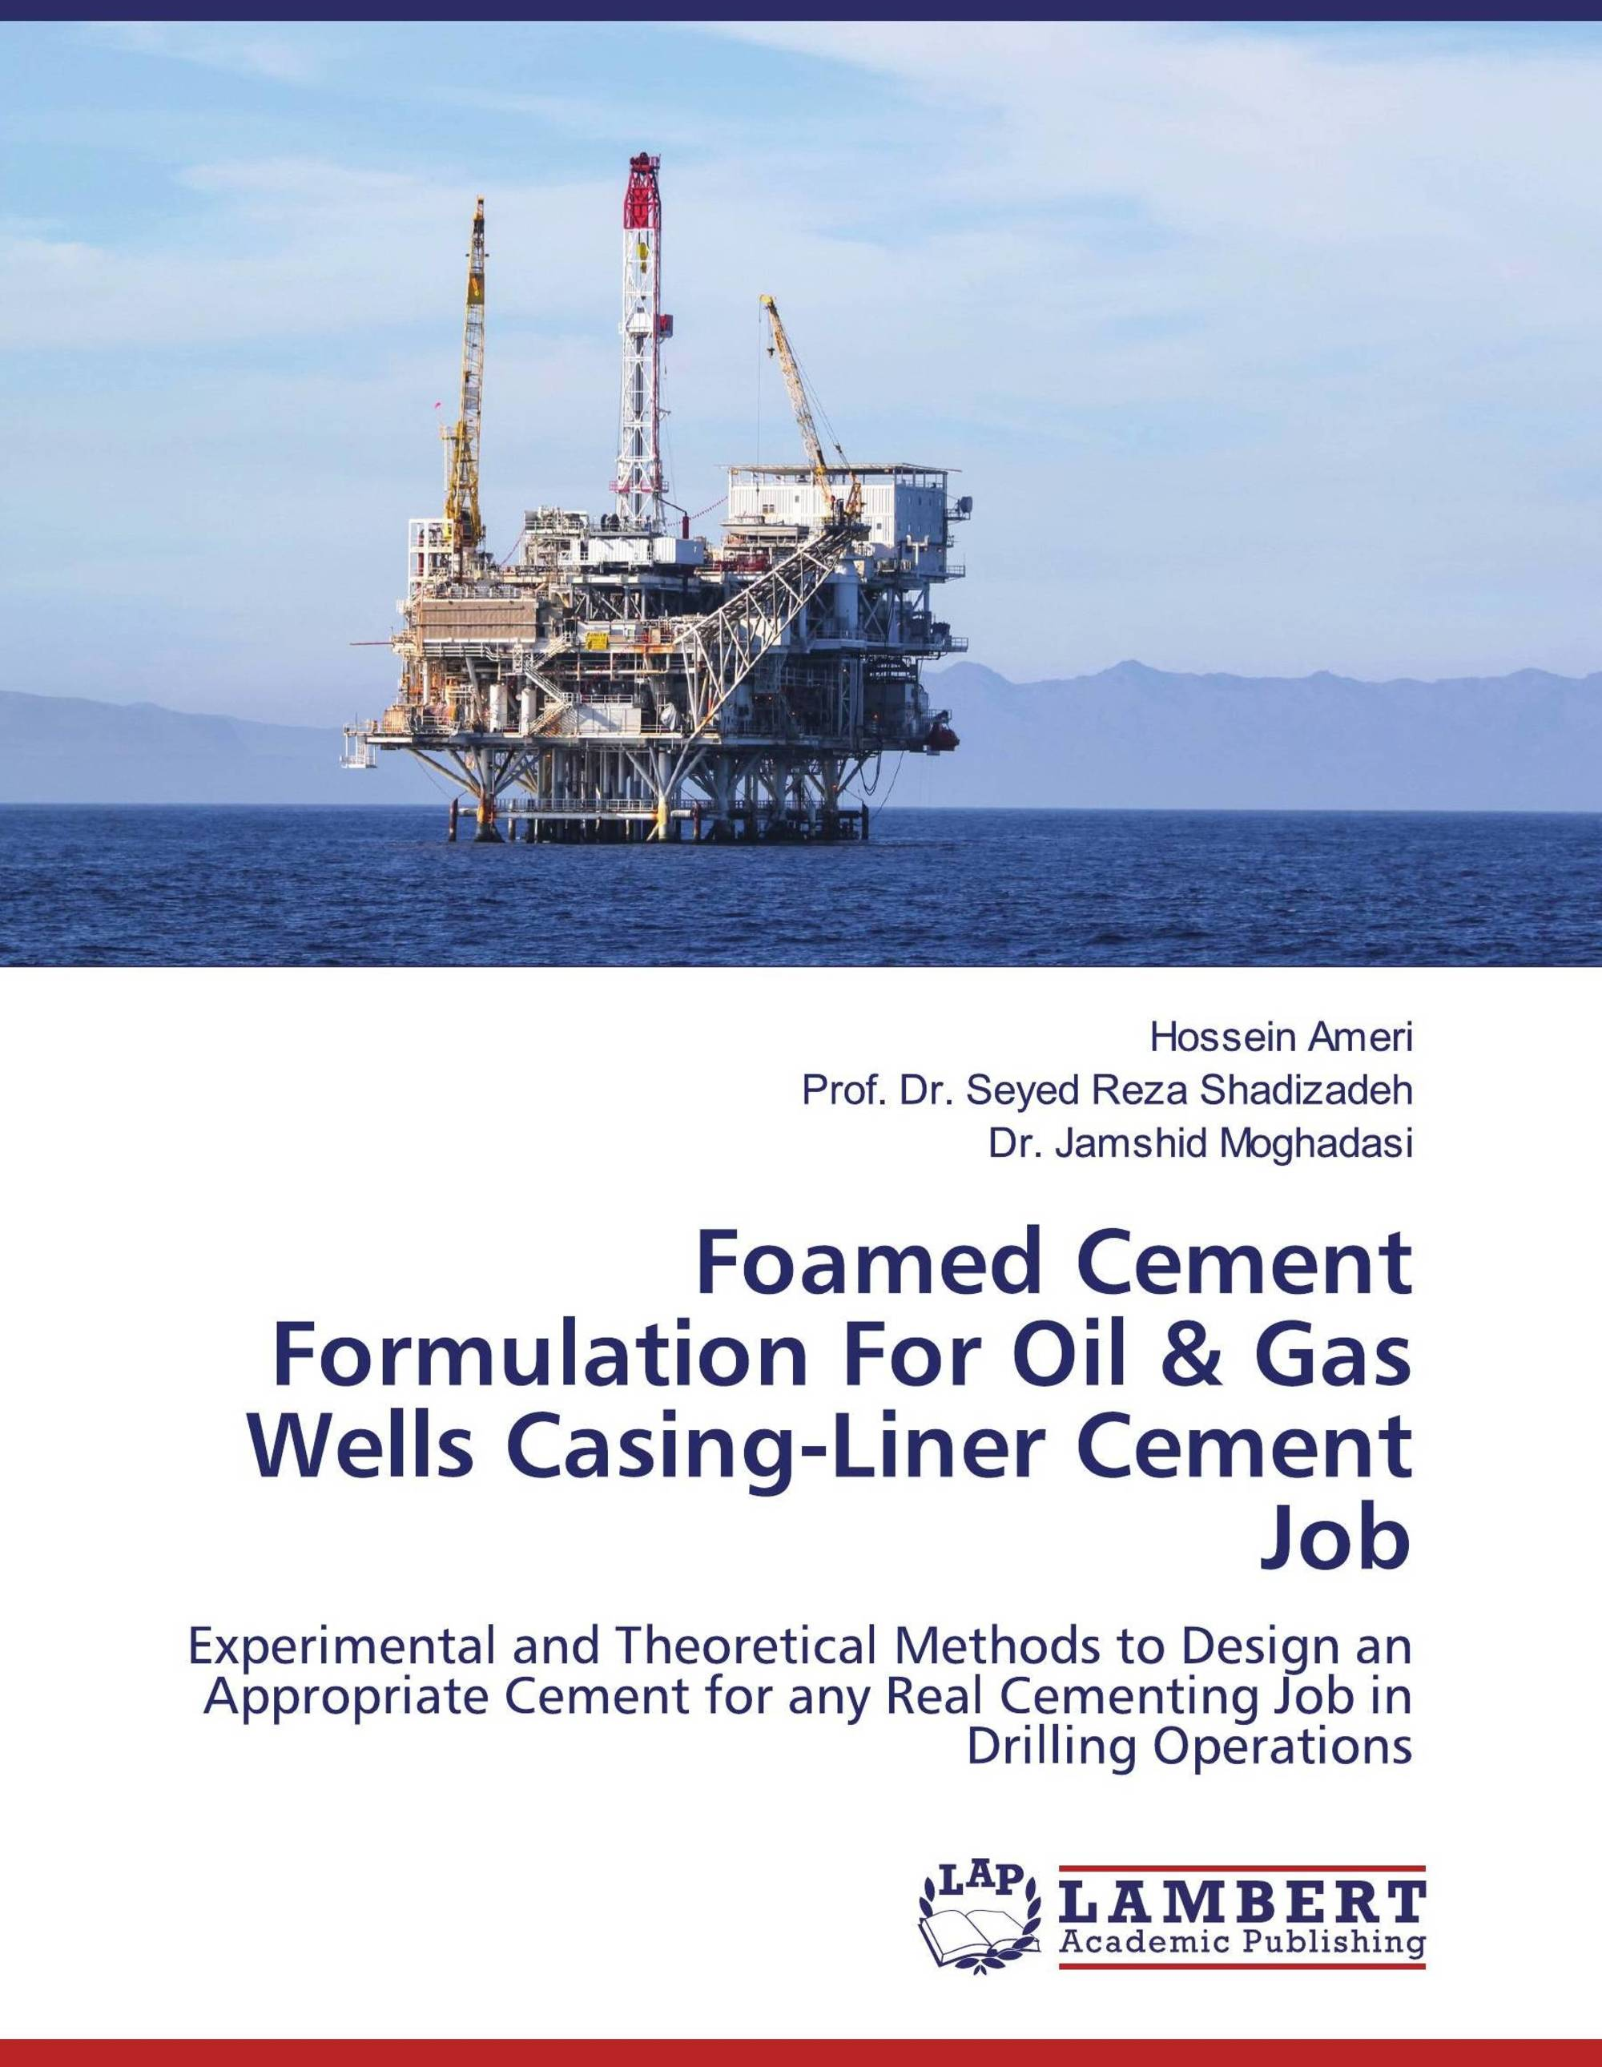


References :
https://doi.org/10.1016/S1002-0071(12)60038-0
https://doi.org/ 10.1016/j.petrol.2015.02.009
https://doi.org/ 10.1016/j.conbuildmat.2018.11.265
https://doi.org/ 10.1371/journal.pone.0191370
https://doi.org/ 10.1016/j.jngse.2020.103416
https://doi.org/ 10.1016/j.cemconres.2018.06.014
https://doi.org/ 10.1016/S0040-8166(98)80047-5
https://doi.org/ 10.1016/j.petrol.2019.106292
https://doi.org/ 10.1080/15583724.2021.2007121

Slide 21

Thank You
I hope You liked it.

